Slide 1




HealthOps 360
Presented by
  Mohamed Mahmoud Farouk Abouzeid
  Safa Ahmed Salah Khamis
  Hajar Mohamed Hamed El-Feki
  Ahmed Ragab Abdallah El-Sayed
  Hossam El-Din Refaat Mohamed Sayed
  Mostafa Karem Mahmoud Ali
Under supervision
ENG.Sarah Besher
2025

Slide 2

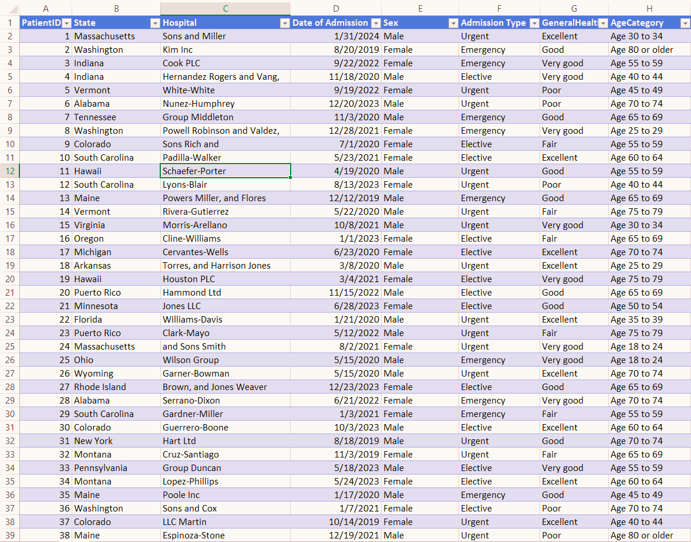
HealthOps 360
Integrated Healthcare Data Analysis
A Unified Platform for Demographic, Clinical, and Financial Patient Data
Analysis of 55,500 Health Records
Proposed Model for the Egyptian Healthcare System
2025
Project Identity
Crimson Red – #a1343c
Strength, decisiveness, professionalism
Highlights key insights, risks, recommendations
Rose Blush – #db636f
Human touch, connects data to patient care
Makes clinical info approachable
Soft Ivory – #fefcf8
Clean, neutral background
Enhances readability and emphasizes charts/results
Crimson Red
Rose Blush
Soft Ivory

Slide 3

Project Introduction
The purpose of the data
Analysis of 55,500 patient records in the United States, including demographic, clinical, and financial data, aimed at developing a unified platform to support healthcare decision-making through integrated data.
The main goal of the project
This project serves as a preliminary experiment to explore the feasibility of applying it later to data related to the Arab Republic of Egypt. It aims to contribute to the development of the healthcare system within the framework of the National Digital Health Strategy 2025–2029, which seeks to:
  Improve citizens’ health and ensure their access to equitable, high-quality medical services.
  Enhance governance of the health sector by improving resource management, increasing transparency, and providing accurate data.
  Accelerate digital transformation by building an integrated healthcare system based on data standardization and interoperability.
Alignment with Egypt’s National Strategy:
  Unified Medical Record: Our Power BI data modeling mirrors the national approach of linking citizen records, visits, and costs.
  Data-Driven Decision Making: The project produces dashboards ready for informed operational and strategic decisions.
  Universal Health Insurance Initiatives: Financial and clinical analyses form the basis for pricing and quality assurance.

Slide 4


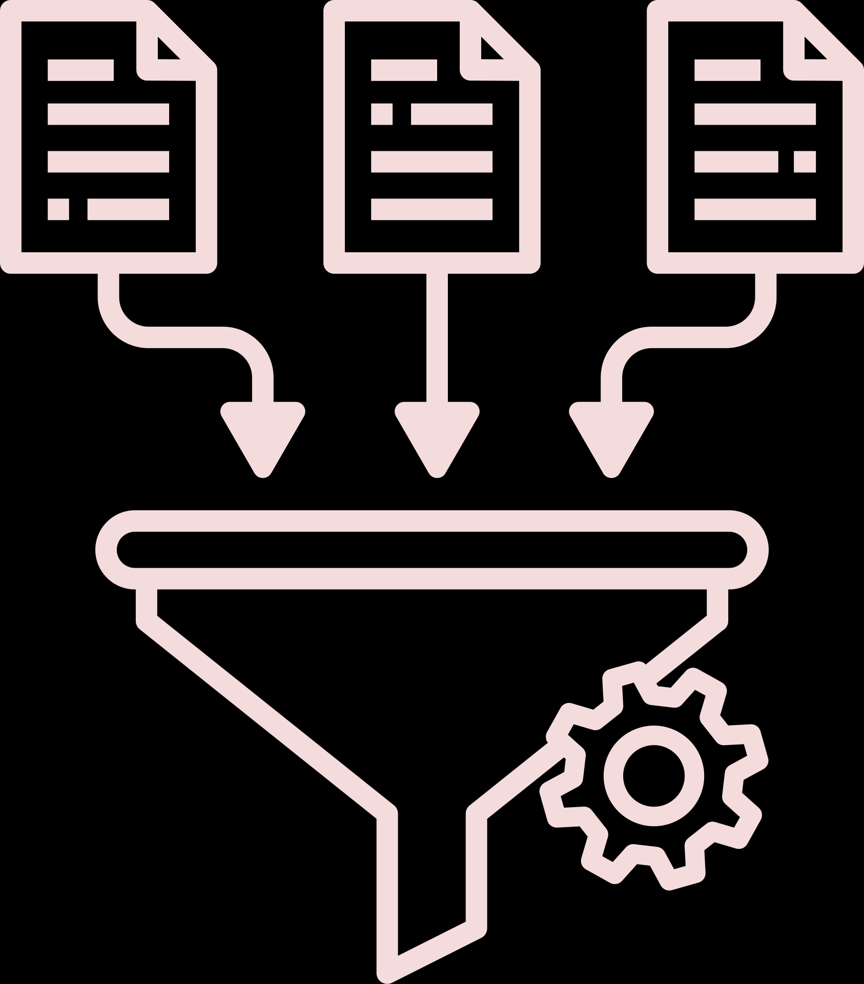

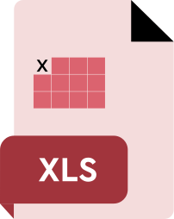



Implementation Roadmap
Data Collection
Data Cleaning & Preparation
Defining Analytical Objectives
Excel Analysis
Power BI & Tableau Dashboards
Advanced Python & SQL Analysis
Gathering raw hospital records needed for analysis.
Fixing errors, removing inconsistencies,and structuring data.
Identifying the main questions and KPIs to be analyzed.
Performing initial calculations and exploratory insights.
Building interactive visual dashboards for decision-making.
Running deeper analytical models and database queries.

Slide 5
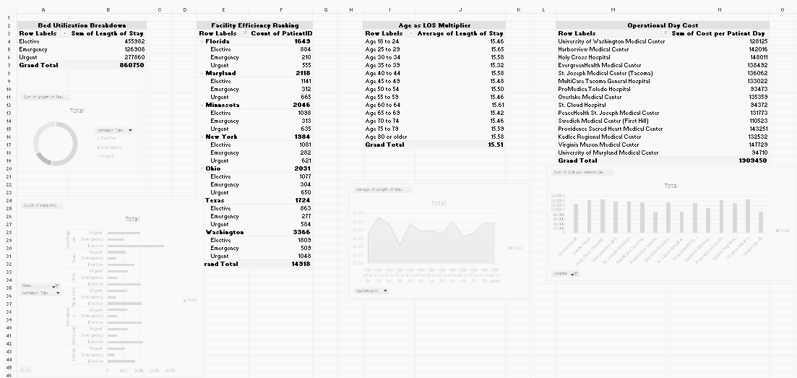
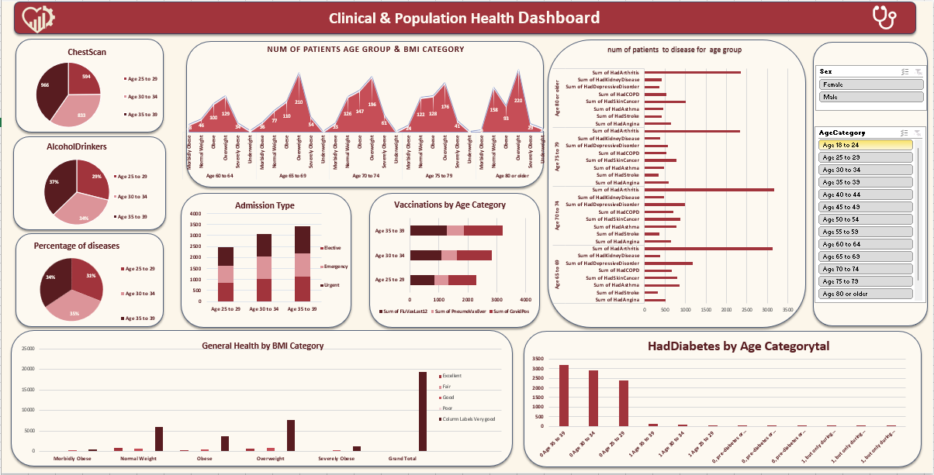
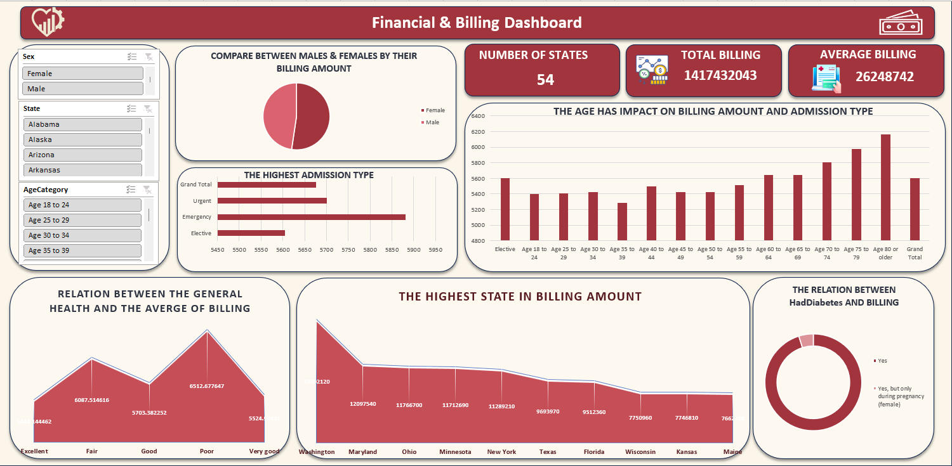
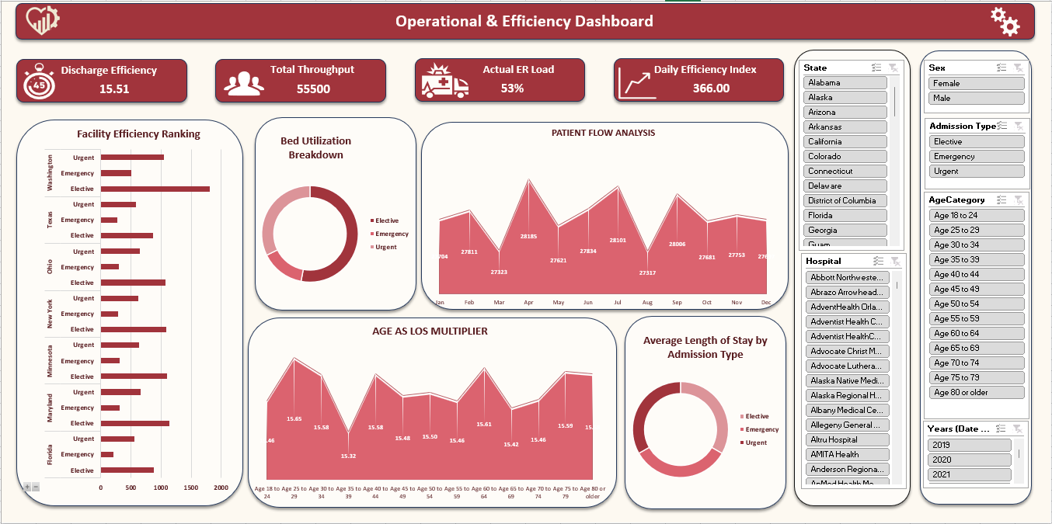
Excel for Analysis
Excel served as the initial lab for the data, where preliminary inspection, error detection, and data preparation were performed before moving on to more advanced tools.
Core Role
  Initial Inspection
  Data Cleaning
  Adding Calculated Columns
  Pivot Analysis
  Building the first draft dashboard
Key Benefits
  Clear understanding of raw data ,Reviewing each record enabled the detection of null values, misspellings, and data inconsistencies.
  Critical computed metrics Such as BMI and Length of Stay to validate numerical accuracy.
  Pivot Tables as a foundational reference Creating numerical benchmarks for comparison with Power BI and Tableau results later.

Slide 6
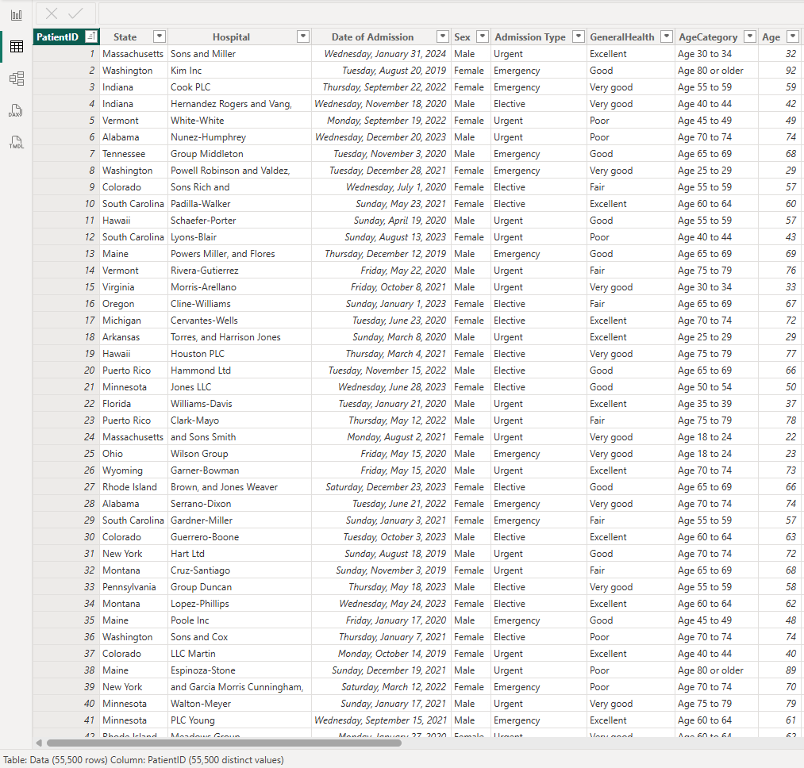

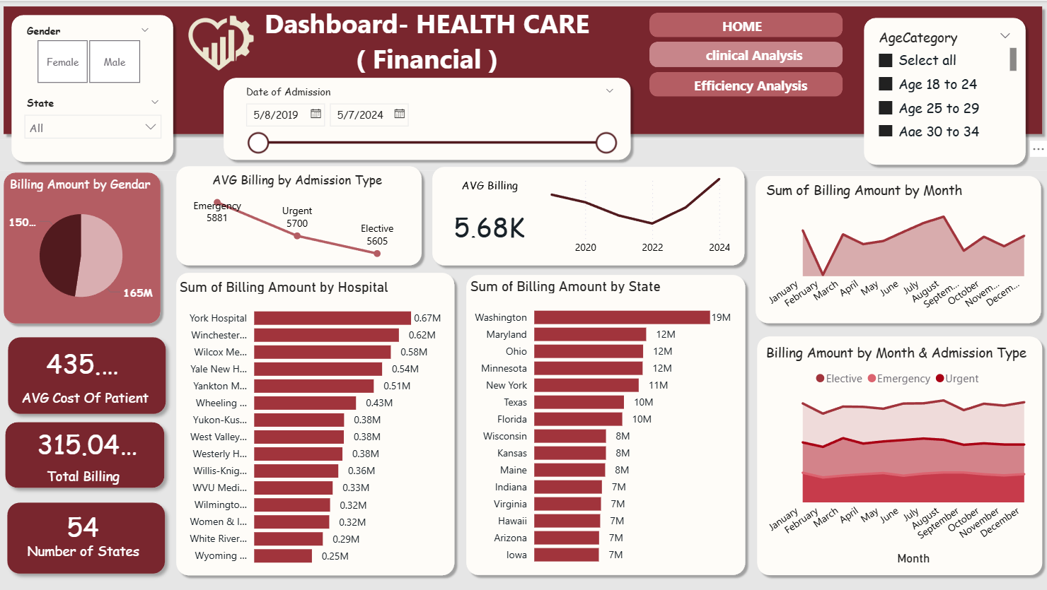
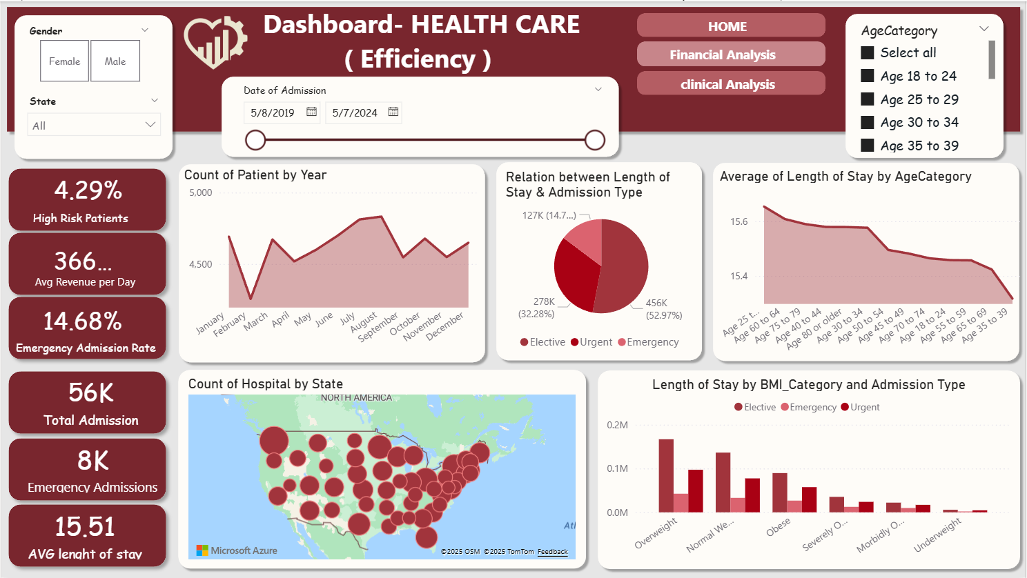
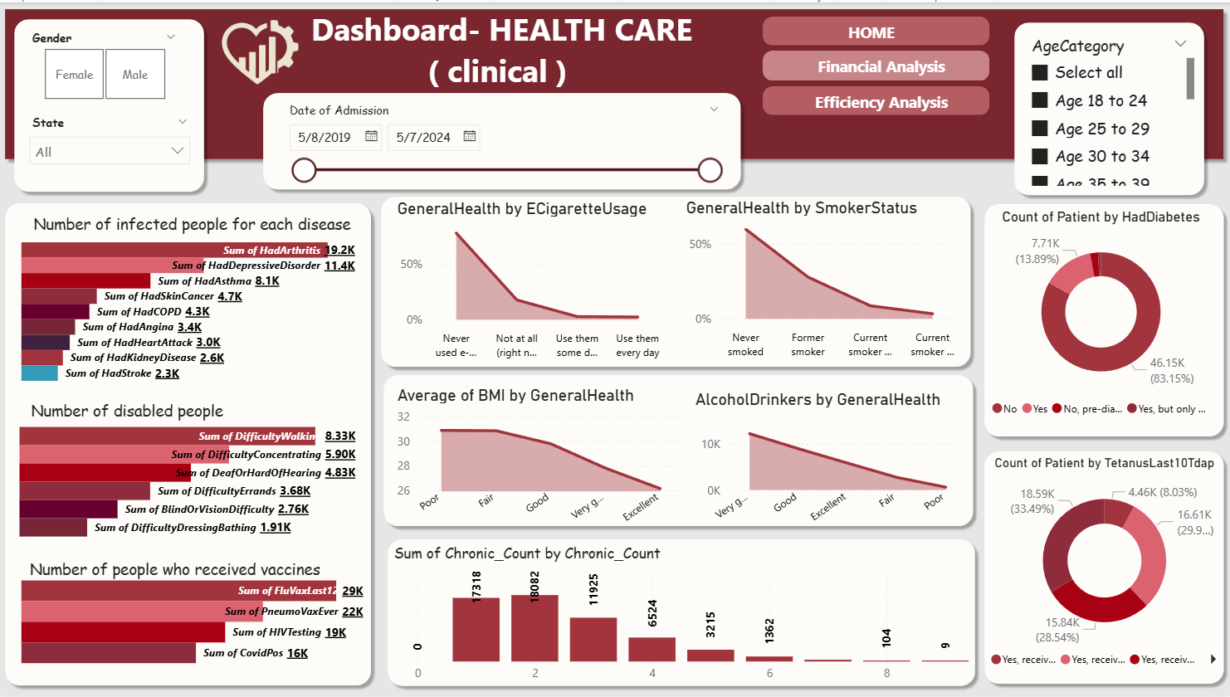
Power BI
Power BI was the project’s main engine—the most comprehensive tool combining data analysis, modeling, table relationships, and advanced KPI creation.
Core Role
  Data Modeling
  Advanced KPIs
  Interactive Dashboards
  ETL Automation through Power Query
Power BI’s Real Strength
  Automated Data Cleaning (ETL Automation) All transformation steps were recorded for future automatic updates.
  Data Modeling (Relationships) Connecting tables such as Patients – Costs – Hospitals enabled multidimensional analysis.
  DAX Measures
Creating advanced indicators like:
(Cost Per Day , Time Intelligence , Patient Risk Grouping
  Interactivity
Cross-filtering, drill-through, and dynamic views.

Slide 7
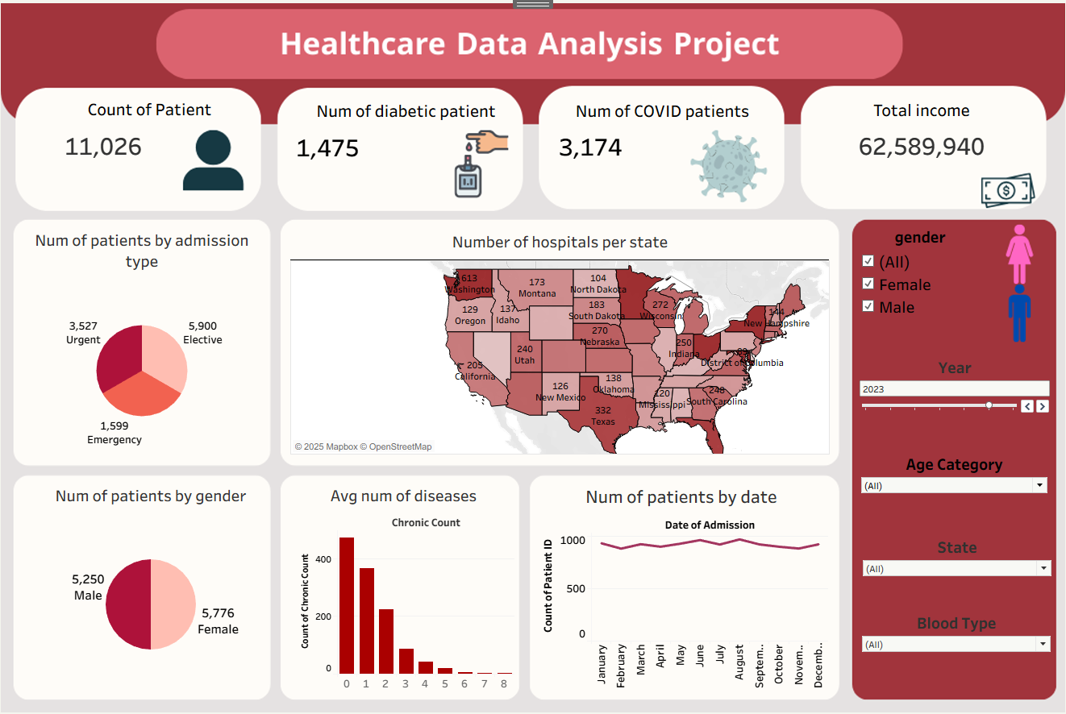
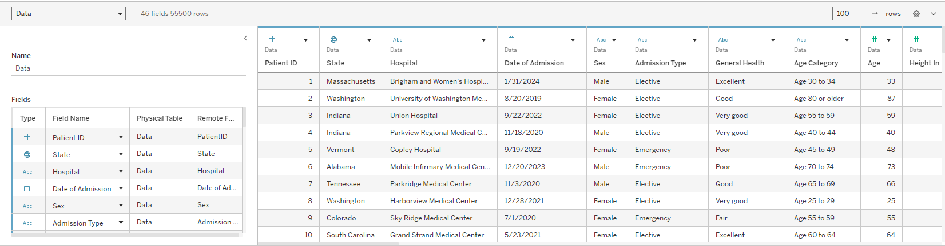
Tableau
Tableau was used for fast and intuitive visual exploration, emphasizing ease of use, instant pattern recognition, and storytelling. It was also used to create a comprehensive project-wide dashboard.
Core Role
  Exploratory Data Analysis
  Interactive Visuals
  Geographic & Demographic Patterns
Key Benefits
  Rapid chart creation
Quickly analyze patient distributions by age and location.
  Outlier detection
Identify anomalous values, such as extremely high-cost cases.
  Storytelling
Present the “data story” visually in a smooth and engaging way.
  Project Dashboard
Enabled the creation of an overall dashboard summarizing the entire project for stakeholders.

Slide 8
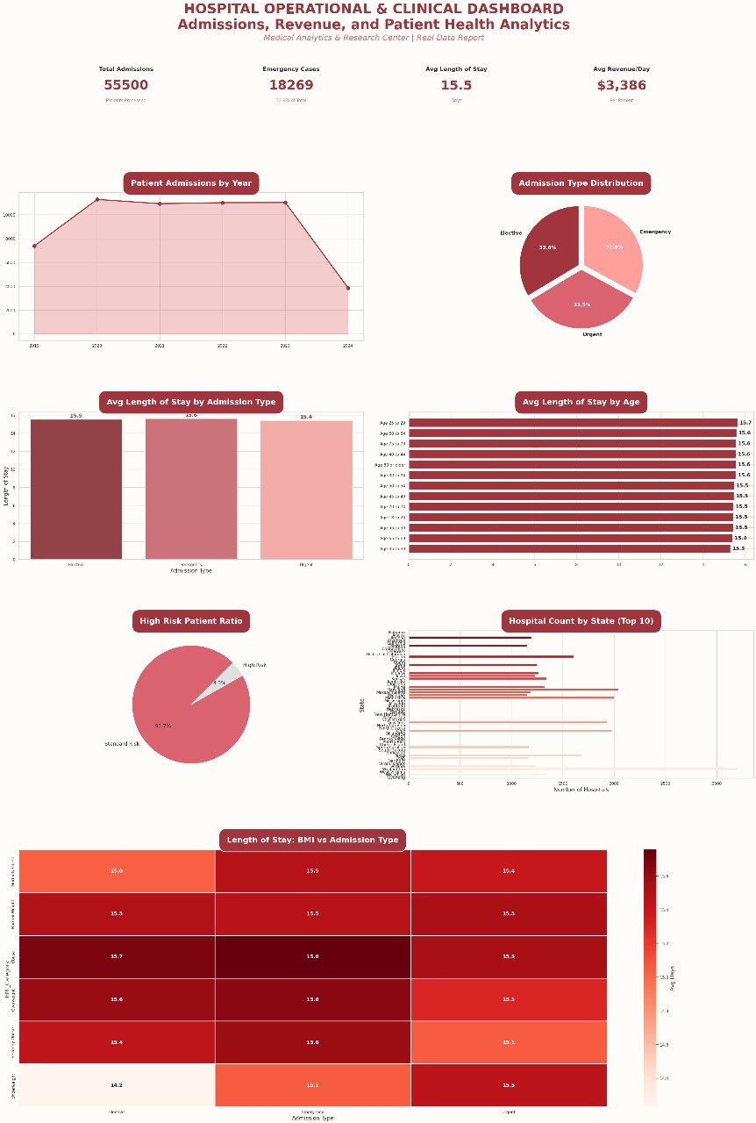
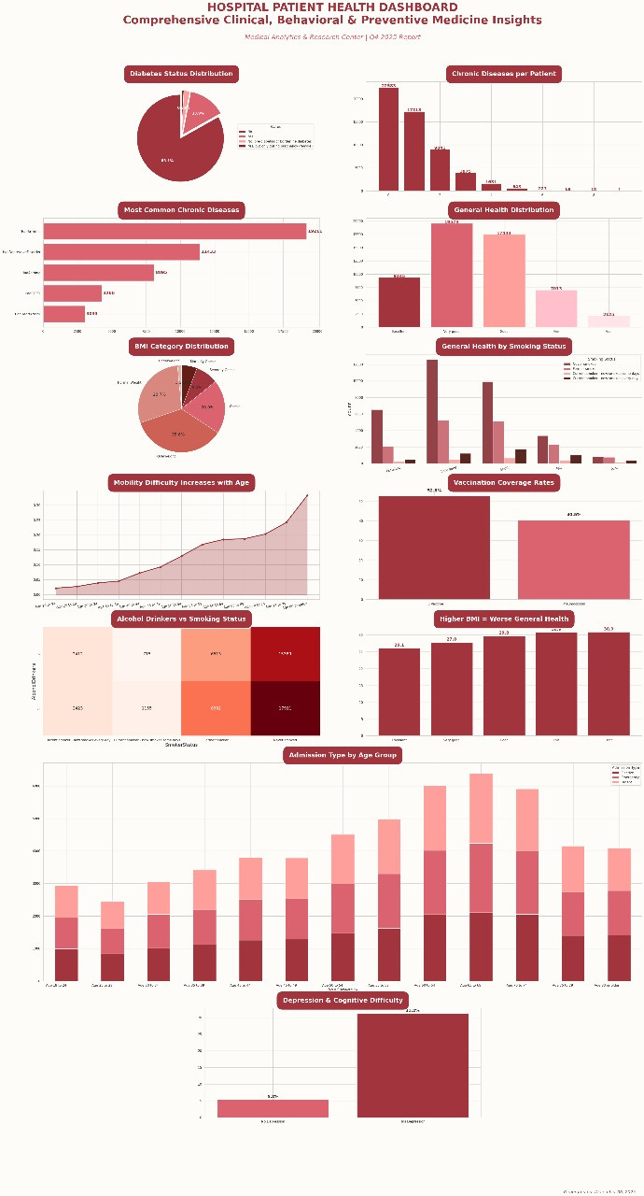
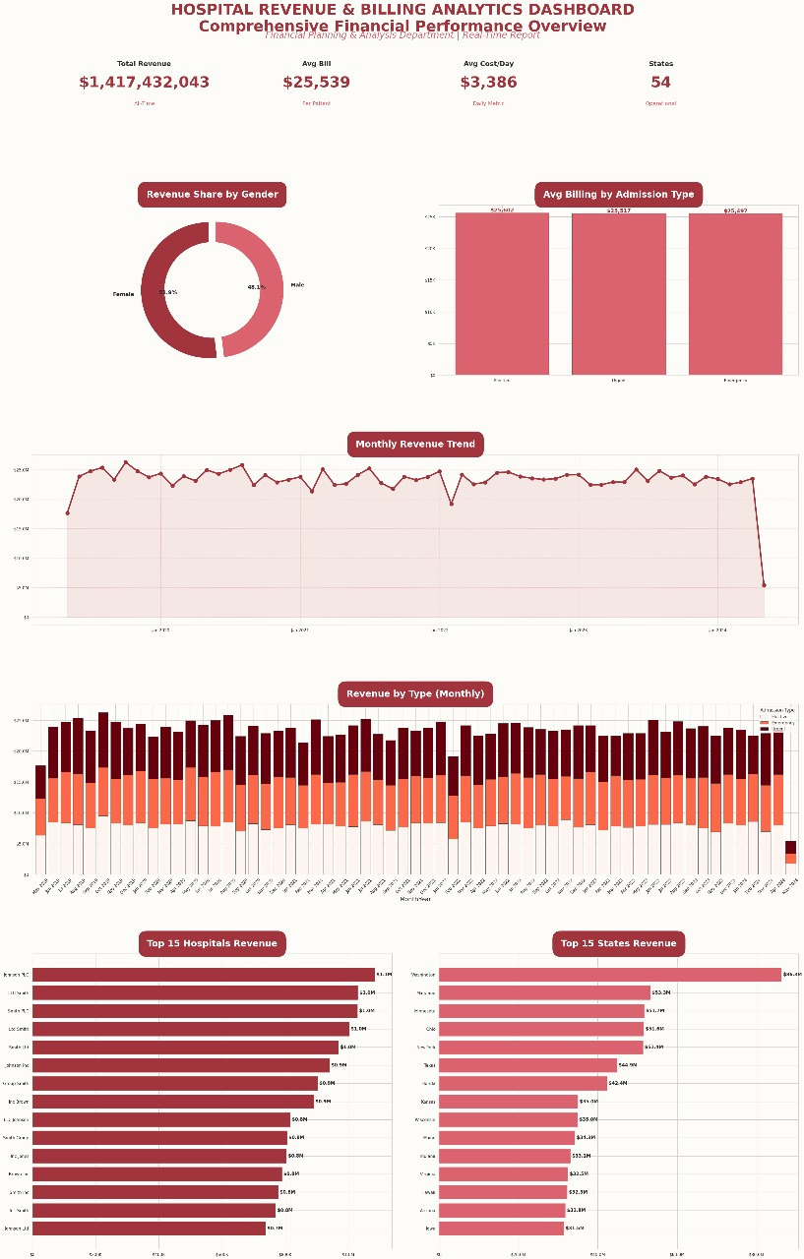
Python for Analysis
Python added the advanced analytical dimension through programmatic processing.
Core Role
  Cleaning data using Pandas
  Computing statistical relationships
  Building predictive models
  Visualization with Matplotlib
  Producing analytical figures that support decision-making

Slide 9
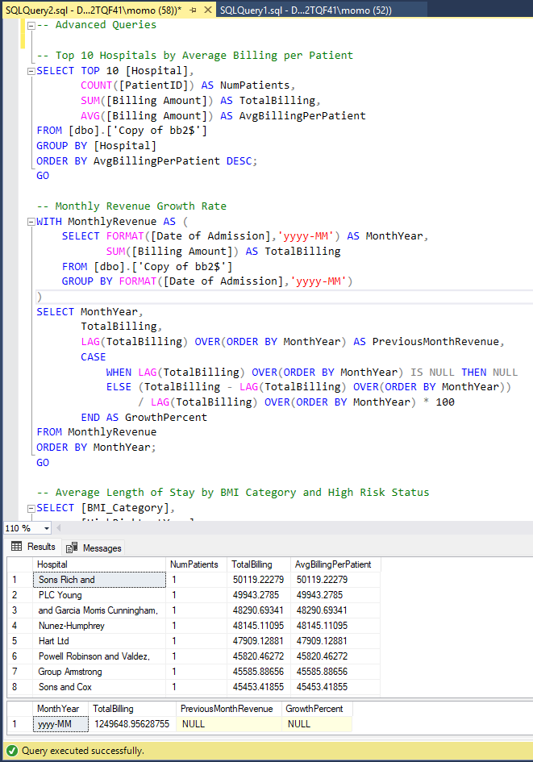
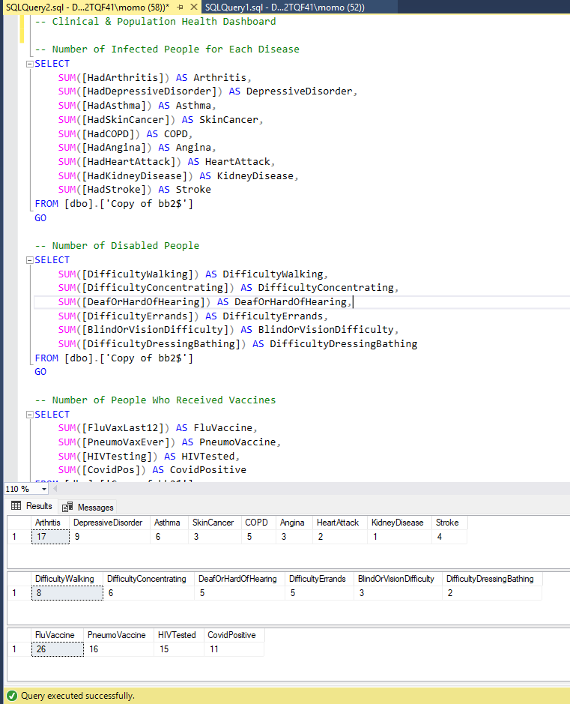
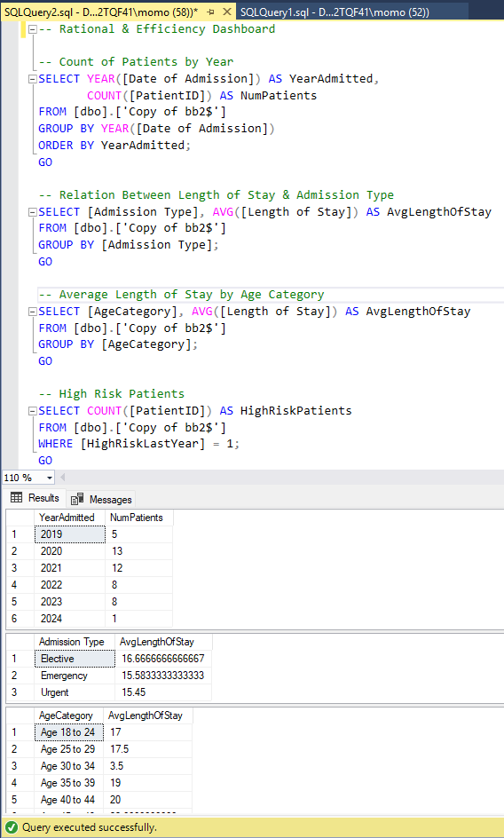
Data Analysis Using SQL
SQL provided direct access to the data source, validating its structure and enabling analytical queries.
Core Role
  Extracting raw data
  Validating data types
  Sampling
  Performing aggregations and KPIs
  Executing queries supporting analytical objectives

Slide 10
Key Results & Executive Recommendations
Key Results
Executive Recommendations
Financial Insights
  Emergency admission costs are 2.8× higher than regular admissions.
  Top-performing hospitals/states generate 68% of total revenue.
  Significant variation in daily costs between chronic and acute cases.
Operational Insights
  Chronic patients stay 52% longer on average.
  Predictive analysis identifies peak periods, optimizing workforce allocation.
  Highlights departments with highest operational resource consumption.
Clinical Insights
  High prevalence of Diabetes and COPD.
  Smoking associated with 40% higher medical bills.
  Clear differences in length of stay and costs by disease type and severity.
Total Impact
  Data-driven improvements could save $4.2 – $7.8 million annually for a medium-sized hospital.
  Chronic Disease Programs – Target high-risk states/regions using Tableau maps and clinical patterns.
  Strengthening Emergency Resources – Increase staff & equipment during peak periods (Power BI Forecast).
  Anti-Smoking & Obesity Campaigns – Python-based models show ROI > 300%.
  Standardizing Vaccinations & KPIs – Use Excel/Power BI templates for consistent financial & clinical indicators.
  Continuous Monitoring Platform – Adopt the analytical platform for monthly operational & administrative decision support.
  Pilot Projects – Start small, expand based on field results and dashboard insights.

Slide 11

Conclusion
This project represents a practical and integrated model for healthcare data analysis, starting from data cleaning and preparation to building advanced analytical dashboards.
The analysis demonstrated the power of data in:
✔ Enhancing the quality of healthcare
✔ Reducing operational costs
✔ Supporting medical and administrative decision-making with accuracy
✔ Strengthening governance and improving hospital efficiency
✔ Laying the foundation for a fully integrated digital health system
Thanks to the integration of Excel, Power BI, Tableau, Python, and SQL, the data was transformed from raw numbers into a strategic tool that supports the Egyptian healthcare system and aligns with the national digital health transformation vision.
In summary:
This project is more than just an analysis—it's a meaningful step toward building a smart, connected, and efficient healthcare ecosystem that serves citizens and supports the sustainability of the health sector.
github//HealthOps 360

